Slide 1
Individual Assay Results MB2 and SDA Assay
Master Thesis
Marius Czech

Slide 2
All MB2 assays for MgPol and respective constructs
a dotted line symbolizes excluded assays

Slide 3
MgPol

Slide 4
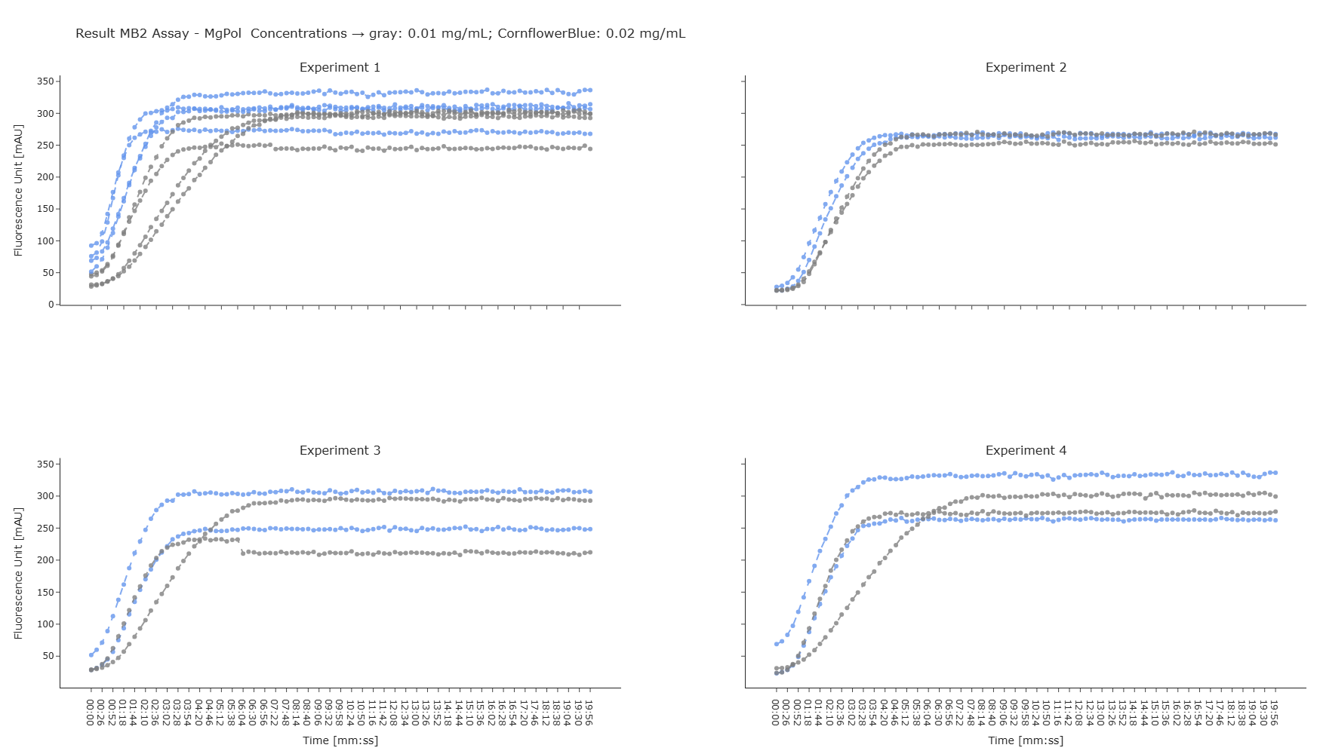

Slide 5
FP3-MgPol

Slide 6
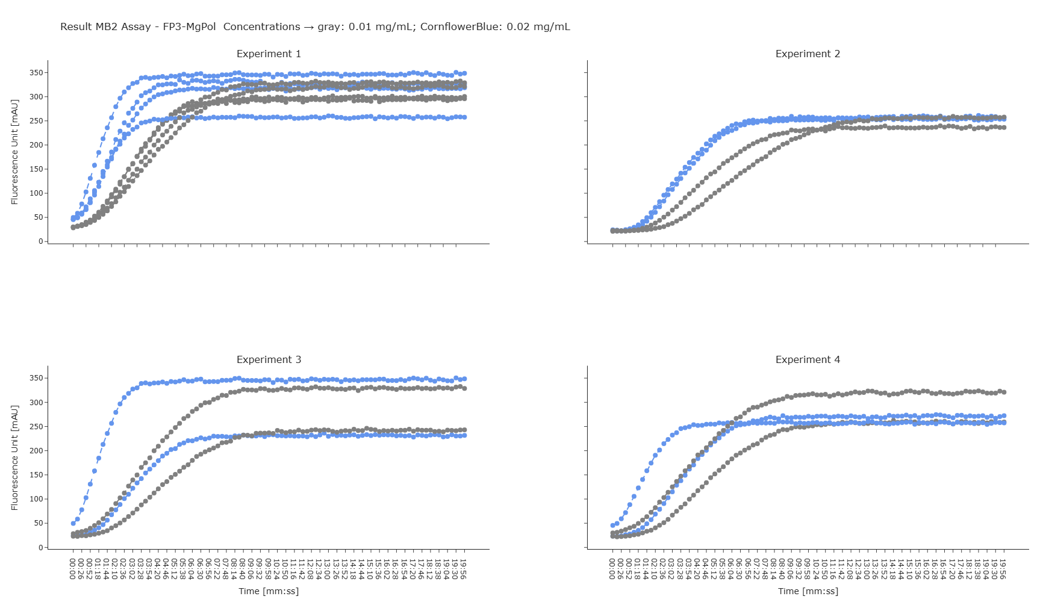

Slide 7
FP5-MgPol

Slide 8
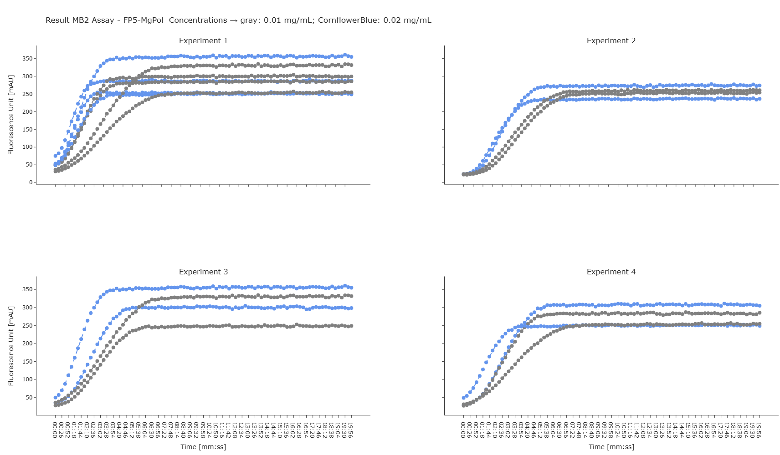

Slide 9
All SDA assays for MgPol and respective constructs
a dashed line symbolizes excluded assays

Slide 10
MgPol

Slide 11
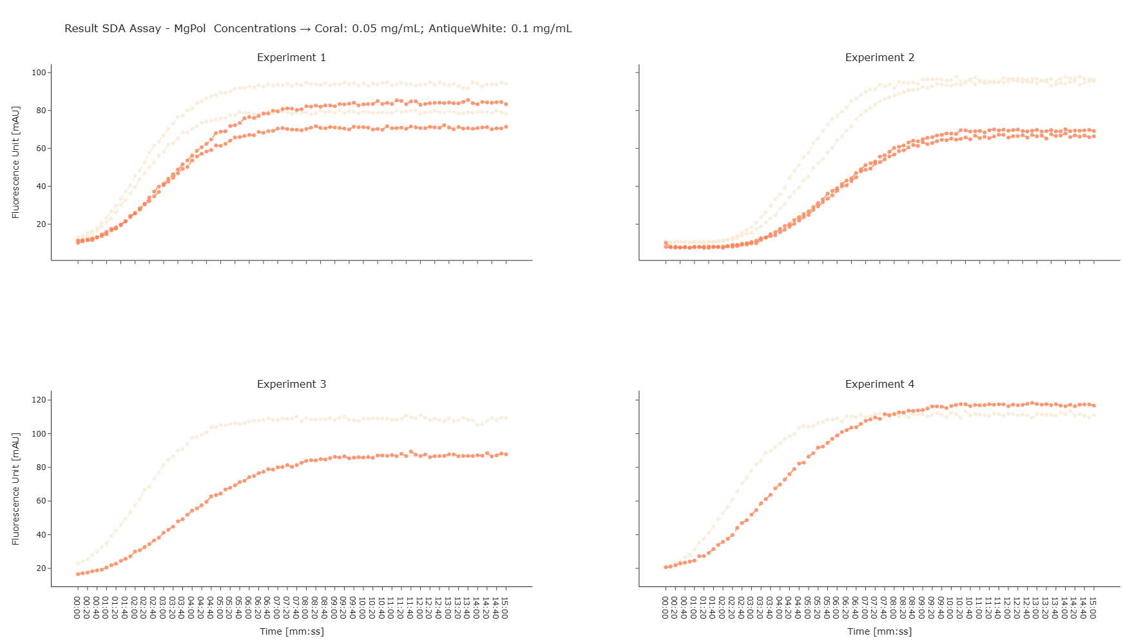

Slide 12
FP3-MgPol

Slide 13
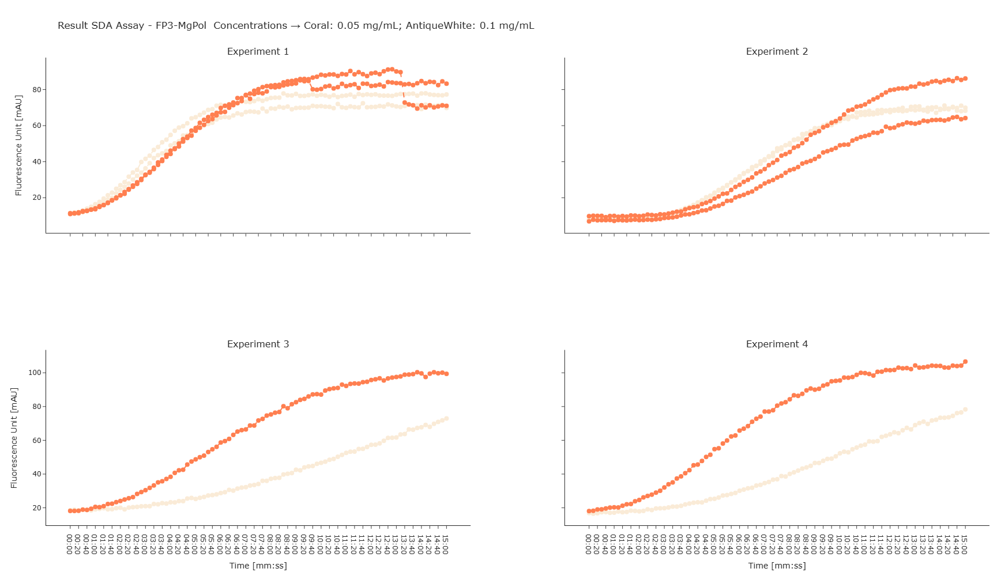

Slide 14
FP5-MgPol

Slide 15
